Slide 1
Statistics for Linguists
2023-11-15
Introduction to basic inferential concepts

Slide 2
From last week
How to plot things
Some starting simulations
Frequency vs. probability distribution

Slide 3
For this week
Lots more simulations
Sample variance
Standard deviation
T statistic (and z statistic)
Probability distributions / functions
p values
Confidence intervals
What’s a linear model
ANOVA (comparing groups)

Slide 4
Preparation
You need to download two databases
Araonavowels
Chacobo forced task
You need to install the following packages
rlist()
tidyverse()
reshape()
Nhstplot()

Slide 5
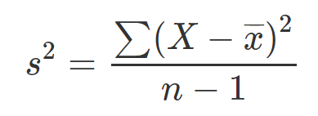
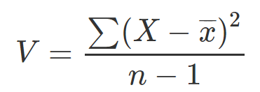
Sample variance

Slide 6
Sample variance
Variance

Slide 7
Sample variance
Sum over all cases of ...

Slide 8
Sample variance
Every value in the sample

Slide 9
Sample variance
minus the mean of the sample

Slide 10
Sample variance
divided by the sample

Slide 11
Variance
What happens to the variance if n increases?
What happens to the variance if values are more spread out?
What is the relationship between variance and the standard deviation?

Slide 12
Variance
What happens to the variance if n increases?
Variance decreases
What happens to the variance if values are more spread out?
Variance increases
What is the relationship between variance and the standard deviation?
The variance is the standard deviation squared.

Slide 13
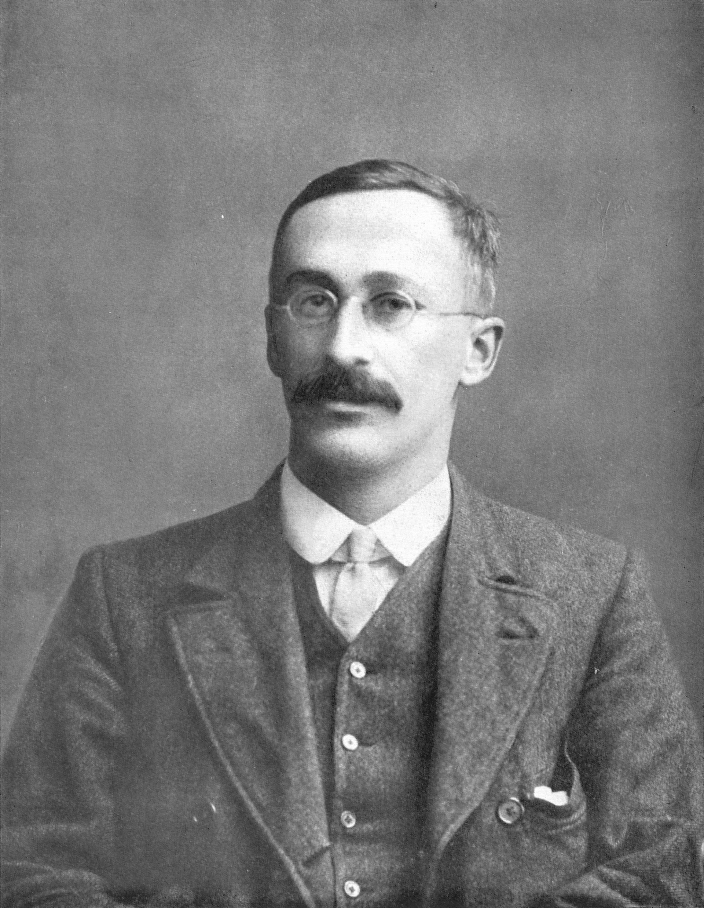
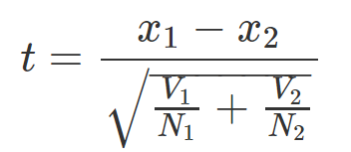
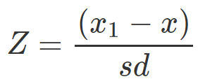
t statistic
William Sealy Gosset
Similar but not the same (z statistic)

Slide 14
T statistic
William Sealy Gosset
group 1 vs. group 2
Similar but not the same (z statistic)

Slide 15

T statistic
What happens to the t statistic as the difference between the means of two groups increase?
What happens to the t statistic as the variance increases in either group?
What happens to the t statistic as the sample size of either group increases?

Slide 16
T statistic
What happens to the t statistic as the difference between the means of two groups increase?
What happens to the t statistic as the variance increases in either group?
What happens to the t statistic as the sample size of either group increases?

Slide 17
T statistic
What happens to the t statistic as the difference between the means of two groups increase?
It depends: if x1 is larger than x2 then t will increase, if x1 is smaller than x2, then t will decrease. But importantly, t will get further away from zero in one of the two directions.
What happens to the t statistic as the variance increases in either group?
The t statistic will get closer to zero
What happens to the t statistic as the sample size of either group increases?
The t statistic will get closer to zero.

Slide 18
P-value and t-statistic
P-values are calculated from t-statistics
P-value conceptually: probability that the groups would be this different from one another if it was true that they were not from the same population

Slide 19
Probability distributions
A probability distribution is a list of all possible outcomes and their corresponding probabilities.
What’s the probability distribution of a coin toss?

Slide 20
Probability distributions
“A probability distribution is a list of all possible outcomes and their corresponding probabilities.”
(Kruschke 2011: 30 Doing Bayesian Data Analysis)
What’s the probability distribution of a coin toss?
p and 1 – p
If its fair its just 0.5 and 0.5

Slide 21
Probability distributions
Probability mass: when we are talking about discrete outcomes.
Probability density: when we are talking about continuous outcomes.
There’s a conceptual difference here: its easy to talk about the probability of specific outcomes which are discrete … but this isn’t true when the values are on a continuum.

Slide 22
Probability distributions
What’s the probability that you will consume exactly 2000.00000…. calories?
Pretty much zero.
What’s the probability that a vowel will be exactly 80.00000…. milliseconds long
Pretty much zero.
Instead, we talk about intervals (e.g. probability of 2000 or higher, probability of vowel being between 70 and 90 milliseconds).

Slide 23
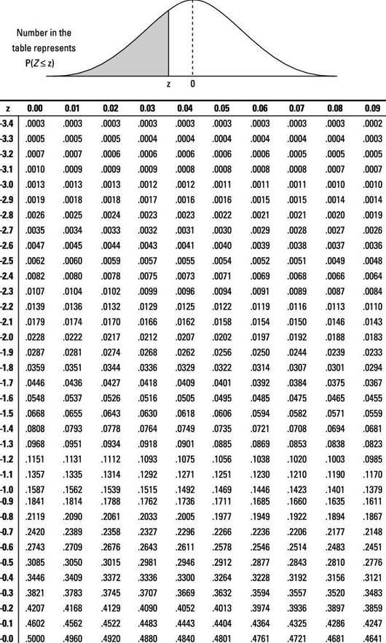
P values
You calculate p values from the t statistic.
And you used to have to look up the results on a chart like this.

Slide 24
P-value
What is a p-value?
How is it calculated?
Why is it calculated this way?

Slide 25
P-value
What is a p-value?
Its an interval probability in relation to a hypothetical distribution that imagines you performed an experiment forever (or gathered data forever).
How is it calculated?
You need a t statistic (z statistic) and a probability distribution (a t distribution if you are doing a t test) -imaginary hypothetical distribution of values we assume if there was no difference between your groups or no relationship between your variables.
Why is it calculated this way?
There’s a complicated historical reason for this - but basically you are calculating the probability of your data given a null hypothesis.
You are not doing the more intuitive thing of calculating the probability of your hypothesis given your data.

